Slide 1
COMP1001
Week 11

Slide 2
What is recursion? What makes a function recursive?

Slide 3
What is recursion? What makes a function recursive?
A recursive function is able to call itself

Slide 4
What is recursion? What makes a function recursive?
A recursive function is able to call itself
Rather than iterating with a loop, a recursive function usually calls itself with a smaller or broken-down version of the input until it reaches an “answer”

Slide 5
What are the two key parts of a recursive function?

Slide 6
What are the two key parts of a recursive function?
Recursive case
Base case

Slide 7
What are the two key parts of a recursive function?
Recursive case:
the function calls itself, with a different (smaller/broken-down) input
Base case:
the function has reached the smallest/simplest version of the problem and stops recursing
(doesn’t call itself further)

Slide 8
In what cases is recursion useful? Where should it be used with caution?

Slide 9
In what cases is recursion useful? Where should it be used with caution?
Useful when an iterative solution requires nesting of loops proportional to the size of the input

Slide 10
In what cases is recursion useful? Where should it be used with caution?
Useful when an iterative solution requires nesting of loops proportional to the size of the input
Otherwise there’s usually an equally elegant iterative solution!
Function calls are computationally expensive so we would select the iterative function in this case

Slide 11
Here’s a function that finds the nth Fibonacci number:
def fib(n):
if n in [0,1]:
return n
return fib(n-1) - fn(n-2)
Visualise it!
https://recursion.vercel.app/

Slide 12
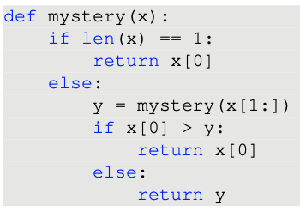
Identify the parts of the function!
Base case
Recursive case
What the function does

Slide 13
Identify the parts of the function!
Base case
Recursive case
What the function does

Slide 14
Identify the parts of the function!
Base case
Recursive case
What the function does
2 | 5 | 3 | 4 | 8
5 | 3 | 4 | 8
3 | 4 | 8
4 | 8
8

Slide 15
Identify the parts of the function!
Base case
Recursive case
What the function does
Returns largest element in list/tuple

Slide 16
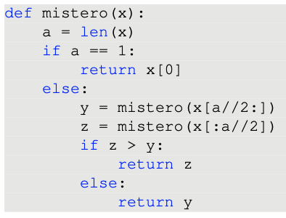
Identify the parts of the function!
Base case
Recursive case
What the function does

Slide 17
Identify the parts of the function!
Base case
Recursive case
What the function does

Slide 18
Identify the parts of the function!
Base case
Recursive case
What the function does
2 | 5 | 3 | 4 | 8
2 | 5
3 | 4 | 8
4 | 8
8
4

Slide 19
Identify the parts of the function!
Base case
Recursive case
What the function does
Returns the largest element in the list/tuple

Slide 20
Identify the parts of the function!
Base case
Recursive case
What the function does
Returns the largest element in the list/tuple
Binary search!

Slide 21
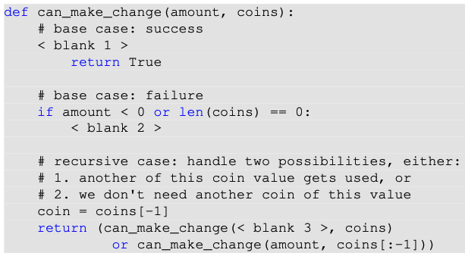
Fill in the blanks!
Is it possible to make some amount from a given selection of coin values, possibly using multiple coins of the same value?

Slide 22
Fill in the blanks!
Is it possible to make some amount from a given selection of coin values, possibly using multiple coins of the same value?
E.g.1 If my amount is 23 and I have coins with values [3,6,8] then I can make 23: 3+6+6+8

Slide 23
Fill in the blanks!
Is it possible to make some amount from a given selection of coin values, possibly using multiple coins of the same value?
E.g.1 If my amount is 23 and I have coins with values [3,6,8] then I can make 23: 3+6+6+8
E.g.2 If my amount is 11 and I have coins with values [2,8,6] then I can’t make 11!

Slide 24
Fill in the blanks!
Is it possible to make some amount from a given selection of coin values, possibly using multiple coins of the same value?
E.g.1 If my amount is 23 and I have coins with values [3,6,8] then I can make 23: 3+6+6+8
E.g.2 If my amount is 11 and I have coins with values [2,8,6] then I can’t make 11!

Slide 25
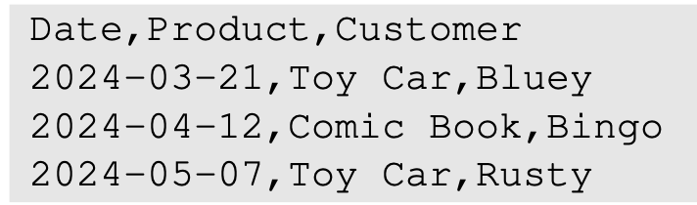
Practice programming
When handling csv files, there are a couple of ways we can get the data out of the csv file and into our program: csv.reader and csv.DictReader. You’ll have used csv.reader in the Grok worksheets, so this time try to use csv.DictReader.
Write a function count_sales(csv_filename), that takes a string csv filename, and returns a dictionary that counts the frequency of products sold. On the example file shown below, it should return:
{'Toy Car': 2, 'Comic Book': 1}

Slide 26
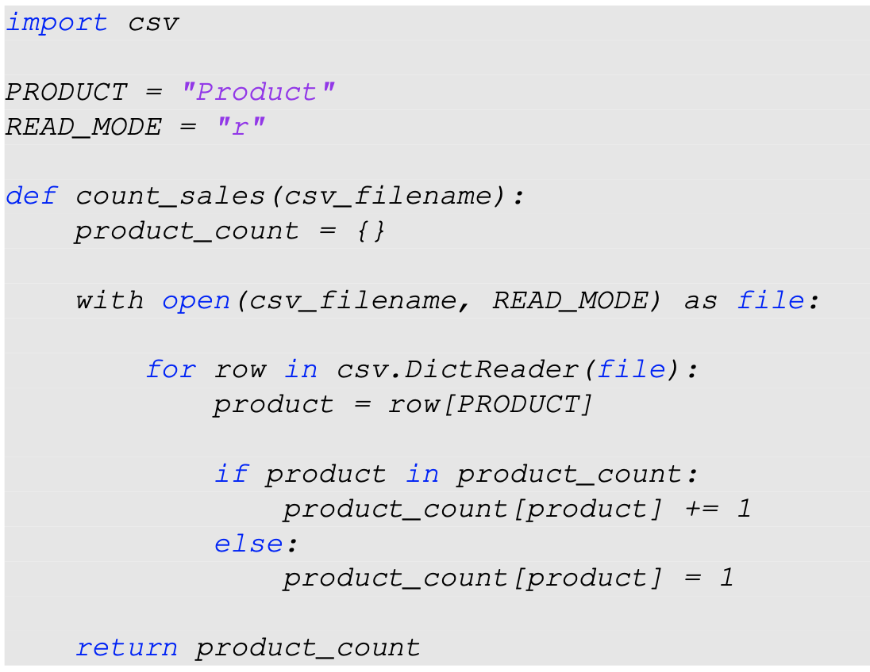

Slide 27
import random
# come up with a large example ...
all_subjects = ["A", "B", "C", "D", "E"]
all_zbinis = [(random.randint(0,255), random.sample(all_subjects, random.randint(1,3))) for i in range(1000)]

Slide 28
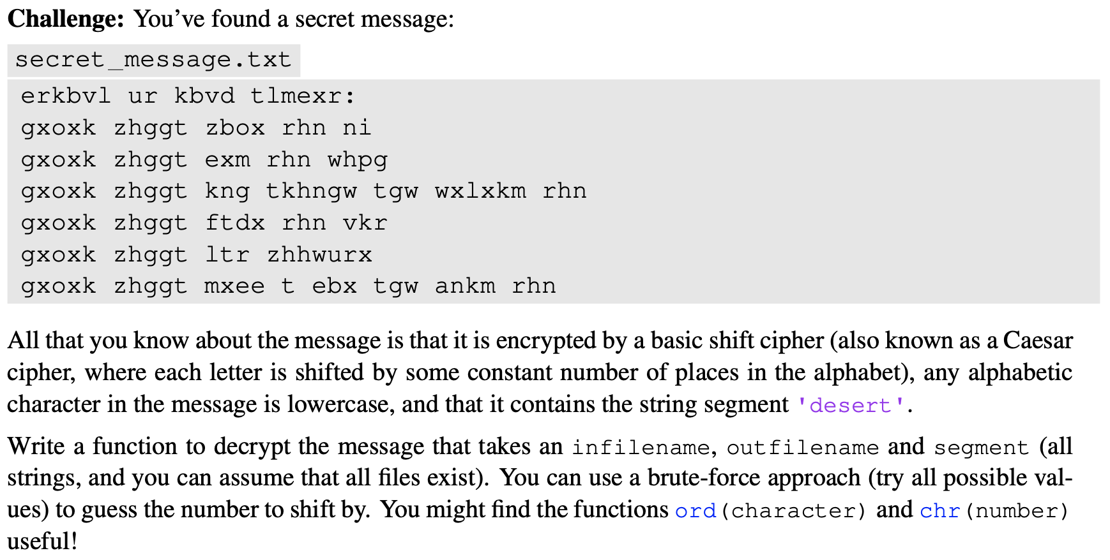

Slide 29
What is an “algorithm”? Why are algorithms a large area of Computer Science

Slide 30
What is an “algorithm”? Why are algorithms a large area of Computer Science
Algorithm: sequence of steps for solving an instance of a particular problem type

Slide 31
What is an “algorithm”? Why are algorithms a large area of Computer Science
Algorithm: sequence of steps for solving an instance of a particular problem type
We have been solving problems with algorithms all semester!
As we deal with more and more data, the efficiency of our algorithms becomes increasingly important
Think of “programming” as “literacy” and “algorithms” as “literature”
Programming: learning rules of grammar and structure so a computer can understand what we intend to communicate
Algorithms: learning good code, elegant ways of solving problems and how to use more advanced vocabulary!

Slide 32
What are the two criteria with which we can judge algorithms?

Slide 33
What are the two criteria with which we can judge algorithms?
Correctness
Efficiency

Slide 34
What are the two criteria with which we can judge algorithms?
Correctness
Does the algorithm give the correct output?
Efficiency
How “good” is the algorithm?
Speed, storage, processing power, etc.
We haven’t looked at this in COMP10001! But it’s important to think about as you learn more about algorithms

Slide 35
What are the two criteria with which we can judge algorithms?
Correctness
Does the algorithm give the correct output?
Efficiency
How “good” is the algorithm?
Speed, storage, processing power, etc.
We haven’t looked at this in COMP10001! But it’s important to think about as you learn more about algorithms
Which would you prefer? An algorithm guaranteed to calculate the correct answer that takes 150 years to finish, or an algorithm that takes seconds but may not always produce the correct result

Slide 36
What is the difference between exact and approximate approaches to algorithm design? Why might an approximate approach be necessary?

Slide 37
What is the difference between exact and approximate approaches to algorithm design? Why might an approximate approach be necessary?
Exact approach: gives correct solution
Approximate approach: gives almost the correct solution, through estimation, simulation, etc.

Slide 38
What is the difference between exact and approximate approaches to algorithm design? Why might an approximate approach be necessary?
Exact approach: gives correct solution
Approximate approach: gives almost the correct solution, through estimation, simulation, etc.
If a problem is too complex to calculate with full completeness, an approximate approach might be more useful!

Slide 39
Are these algorithm types exact or approximate?
Brute force (generate and test)
Heuristic search
Simulation
Divide and conquer

Slide 40
Are these algorithm types exact or approximate?
Brute force (generate and test)
Heuristic search
Simulation
Divide and conquer

Slide 41
Are these algorithm types exact or approximate?
Brute force (generate and test)
Exact. Finds every possible answer and tests it. Requires set of possible answers to be finite to guarantee completion. E.g. linear search
Heuristic search
Simulation
Divide and conquer

Slide 42
Are these algorithm types exact or approximate?
Brute force (generate and test)
Exact. Finds every possible answer and tests it. Requires set of possible answers to be finite to guarantee completion. E.g. linear search
Heuristic search
Approximate. E.g. finding the shortest path to a destination. Finding the definitive solution would require processing many possibilities - we can find an approximate search very quickly. (Ranks alternatives to prioritise possible paths to look at first) May find the exact solution!
Simulation
Divide and conquer

Slide 43
Are these algorithm types exact or approximate?
Brute force (generate and test)
Exact. Finds every possible answer and tests it. Requires set of possible answers to be finite to guarantee completion. E.g. linear search
Heuristic search
Approximate. E.g. finding the shortest path to a destination. Finding the definitive solution would require processing many possibilities - we can find an approximate search very quickly. (Ranks alternatives to prioritise possible paths to look at first) May find the exact solution!
Simulation
Approximate. Finds a solution by generating lots of data to predict an overall trend. E.g. simulate play of a game to find out if it’s worth playing
Divide and conquer

Slide 44
Are these algorithm types exact or approximate?
Brute force (generate and test)
Exact. Finds every possible answer and tests it. Requires set of possible answers to be finite to guarantee completion. E.g. linear search
Heuristic search
Approximate. E.g. finding the shortest path to a destination. Finding the definitive solution would require processing many possibilities - we can find an approximate search very quickly. (Ranks alternatives to prioritise possible paths to look at first) May find the exact solution!
Simulation
Approximate. Finds a solution by generating lots of data to predict an overall trend. E.g. simulate play of a game to find out if it’s worth playing
Divide and conquer
Exact. Divides problem into sub-problems which can be more easily solved. E.g. binary search

Slide 45
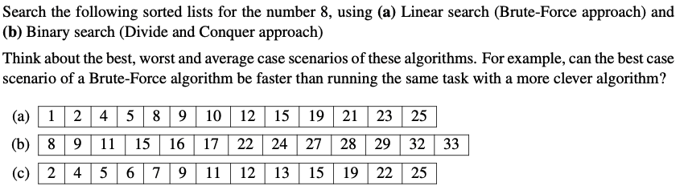

Slide 46


Slide 47
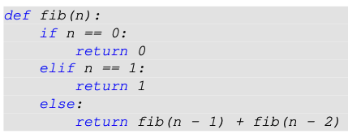

Slide 48
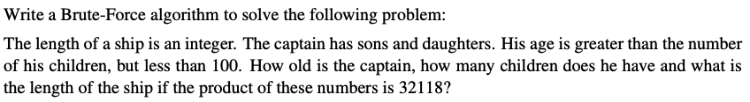

Slide 49
